Slide 1

BI MINI PROJECT
ZOMATO RESTAURANTS ANALYSIS (USING DATASET FROM ZOMATO)
Made By:
Aniket Kumar PF45(1032171203)
Manish Yadav PD15(1032170265)
Rahul Arya PE20(1032170742)

Slide 2

INTRODUCTION
Online food delivery has become an inseparable part of our lives now. Every other day we look to order something or the other to eat from Zomato. Being cautious and improve safety is not a simple instruction anymore. Every day there is a new offer on some or the other restaurant and we have so much to choose from now that we can’t decide anything at all.
Restaurants Analysis is the process of determining the best restaurants , value for money restaurants in their locality. It also helps to find their required cuisines in their locality

Slide 3
ANALYSIS
Which franchise has the highest number of restaurants on Zomato?
How many Restaurants are accepting online orders?
How many Restaurants have a book table facility?
Which location has the highest number of Restaurants?
How many types of Restaurant types are there?
What is the most liked Restaurant type?
What is the Average cost for 2 persons at a particular restaurant?
What is the most liked cuisine type?

Slide 4

DATASET

Slide 5
Name of Dataset: Indian_restaurants_details
Dataset Size: 224520 Rows and 17 Columns (180 MB).
Dataset format: Comma separated value file (CSV).
Description:
Data in this dataset belongs to "Zomato Media Private Limited". Basically the data has all the Zomato restaurants with their ratings, votes and other crucial data attributes to do research work.
Column names of the dataset are:-
Zomato_url, Name ,City, Area, Rating, Rating_count, Telephone, Cuisine, Cost_for_two, Address, Timings , Online_order, Table_reservation, Delivey_only, Famous_food , Longitude, Latitude

Slide 6
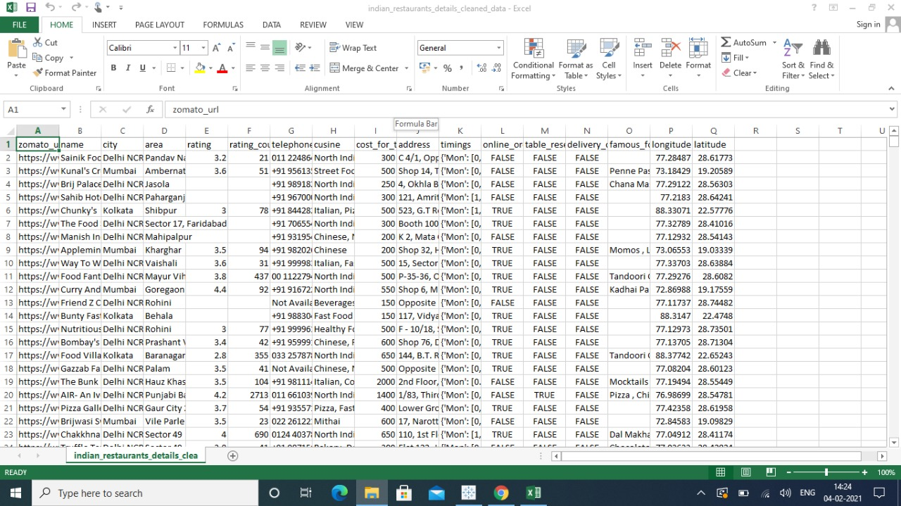
Original Dataset

Slide 7
Data Pre-processing
Summary of dataset
Handling null values
Handling duplicate values

Slide 8
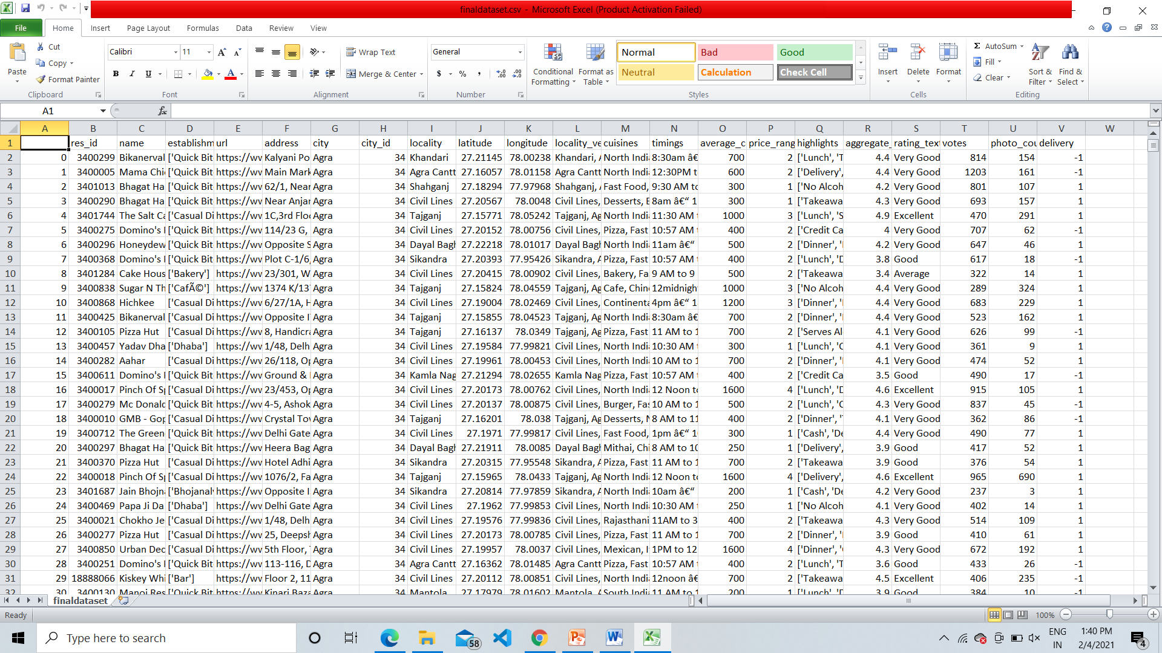
Dataset after Preprocessing

Slide 9

Data Visualization

Slide 10
TABLEAU TOOL
Tableau is a powerful and fastest growing data visualization tool used in the Business Intelligence Industry.
It helps in simplifying raw data in a very easily understandable format.
Tableau helps create the data that can be understood by professionals at any level in an organization.
It also allows non-technical users to create customized dashboards.
Data analysis is very fast with Tableau tool and the visualizations created are in the form of dashboards and worksheets.
The best features of Tableau software are
Data Blending
Real time analysis
Collaboration of data

Slide 11
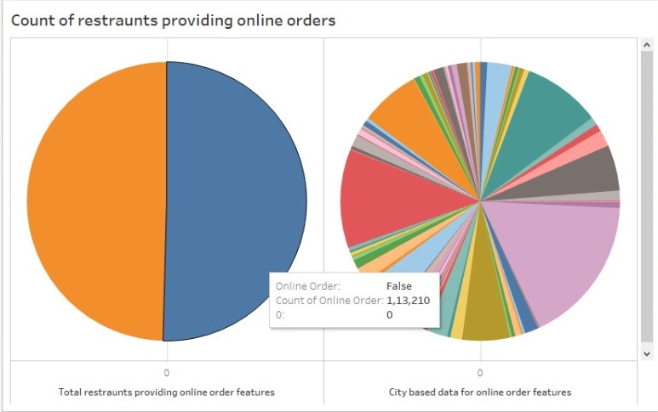
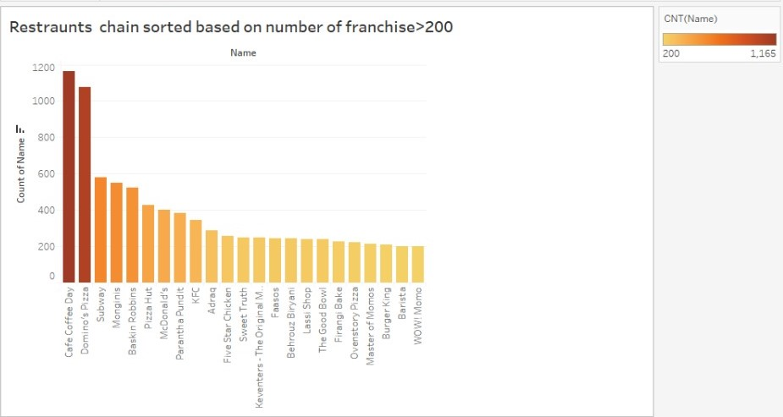

Slide 12
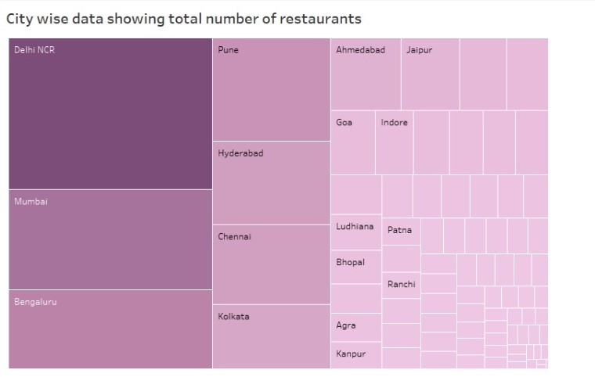
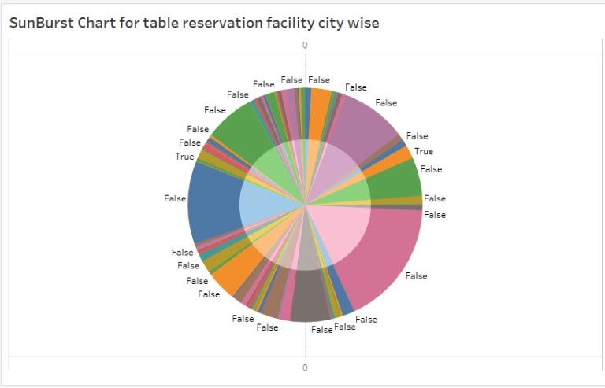

Slide 13
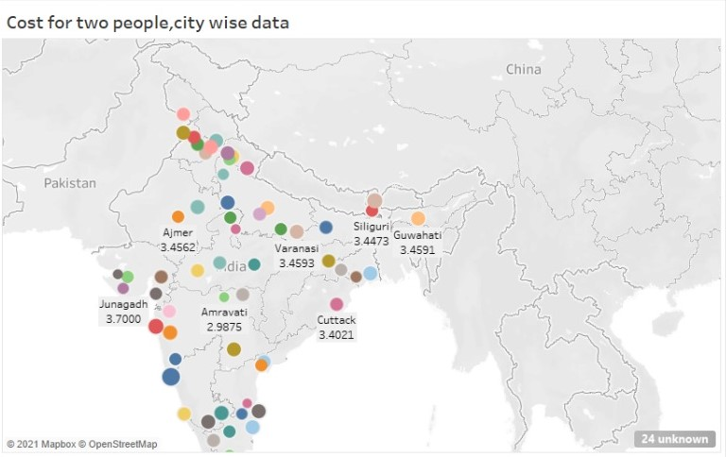

Slide 14
PYTHON
Data visualization is the discipline of trying to understand data by placing it in a visual context so that patterns, trends and correlations that might not otherwise be detected can be exposed.
Python offers multiple great graphing libraries that come packed with lots of different features. No matter if you want to create interactive, live or highly customized plots python has an excellent library for you.

Slide 15
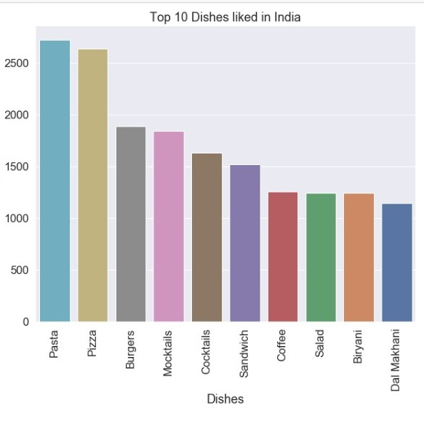
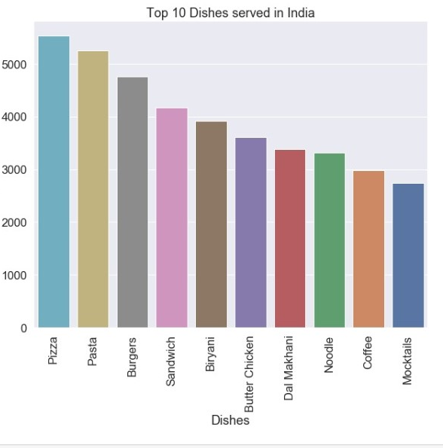

Slide 16

Machine Learning Algorithms

Slide 17
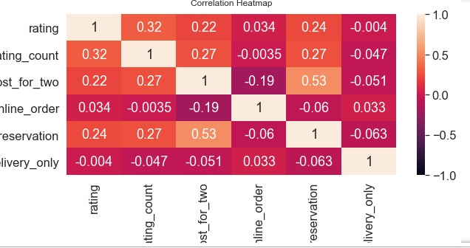

Slide 18
LINEAR REGRESSION
Linear regression is an attractive model because the representation is so simple.
The representation is a linear equation that combines a specific set of input values (x) the solution to which is the predicted output for that set of input values (y). As such, both the input values (x) and the output value are numeric.

Slide 19
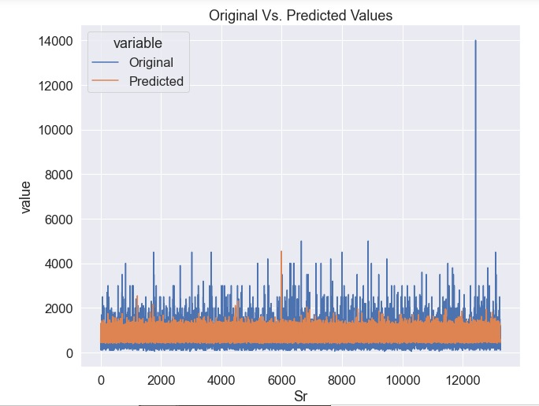

Slide 20
LOGISTIC REGRESSION
Logistic regression is a statistical model that in its basic form uses a logistic function to model a binary dependent variable, although many more complex extensions exist.
In regression analysis, logistic regression (or logit regression) is estimating the parameters of a logistic model (a form of binary regression).

Slide 21
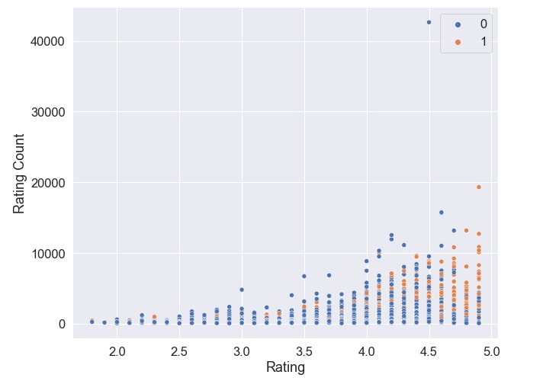

Slide 22
CONCLUSION
We have displayed all the data in a graphical format and used various methods to do it. This gives us a better understanding about the type of dishes and restaurants ,people in India like. We now understand much better what ratings are dependent on and how different methods can be used to represent a dataset and analyze various important results.

Slide 23

Thank You!

